Slide 1
How to complete PPG’s Raw Material Information Request (RMIR) Form

Slide 2

Getting to know PPG
PPG is a global company and maintains a long-standing tradition of developing leading-edge technologies, achieving the highest quality standards and meeting customers’ requirements. Through leadership in innovation, PPG helps customers in industrial, transportation, consumer products, and construction markets and aftermarkets to enhance more surfaces in more ways than does any other company.
Because of this global presence, the materials that will be provided to PPG may be transported or incorporated into products that are distributed anywhere in the world. To accomplish this task legally and safely, and for PPG to meet our sustainability initiatives and commitments to Responsible Care™, PPG requires information about all of your raw materials and products.

Slide 3

PPG RMIR – Raw Material Information Request Form
To approve a Supplier’s material for use, PPG requires suppliers to provide the following information related to their material:
  PPG’s RMIR Form
  Safety Data Sheet(s) (English language and local language where product will be used)
  Certificate of Analysis
  Technical Data Sheet, if available
This information will be reviewed by PPG, and any questions or inconsistent data will be returned to you – the supplier to correct or respond.
This is a critical process, because your information is the basis for PPG product stewardship and product use.
The purpose of this slide set is to help you understand our RMIR process and reduce the “returns” and questions between us, so your product may be approved more quickly and efficiently.
Let’s go through the PPG RMIR.

Slide 4
Lets Begin….
PPG’s RMIR form has 5 Parts (labeled A-E) – all must be completed
A.
Manufacturer, Distributor and Contact Information
Product Information – physical properties, storage information, and anti-static packaging requirements
C.
Compositional Information – a complete listing of the ingredients in the product as sold to PPG
D.
Regulatory Information
E.
Attachments – Safety Data Sheet, Certificate of Analysis, and Technical Data Sheet
B.
The RMIR is Excel-Based, and some of the fields will indicate if information is inconsistent

Slide 5
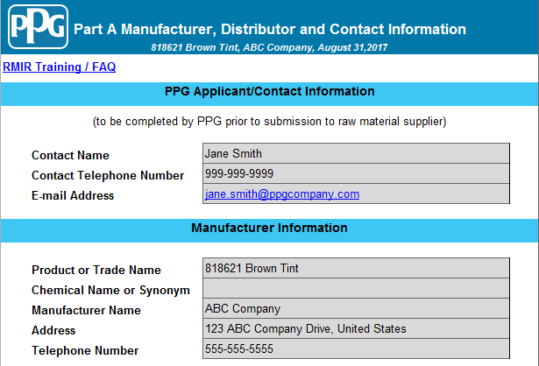
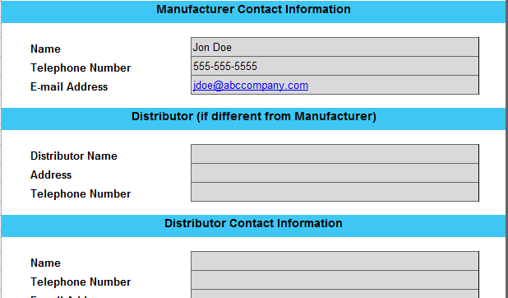
Part A: Manufacturer, Distributor and Contact Information
This will be completed by PPG prior to sending
PPG wants to know the product manufacturer as compared to a distributor.

Slide 6
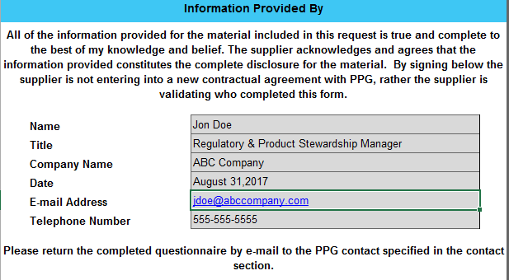
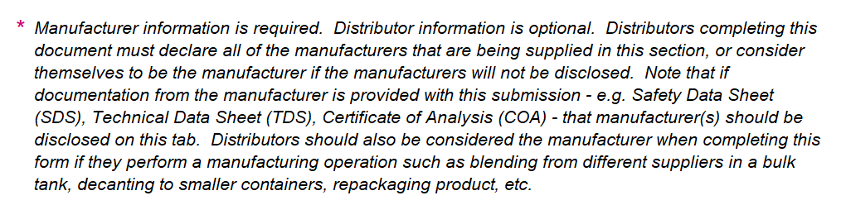
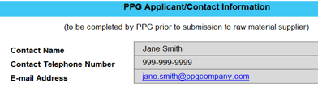
Part A: Manufacturer, Distributor and Contact Information Cont.
Make sure to return this RMIR to the email provided

Slide 7
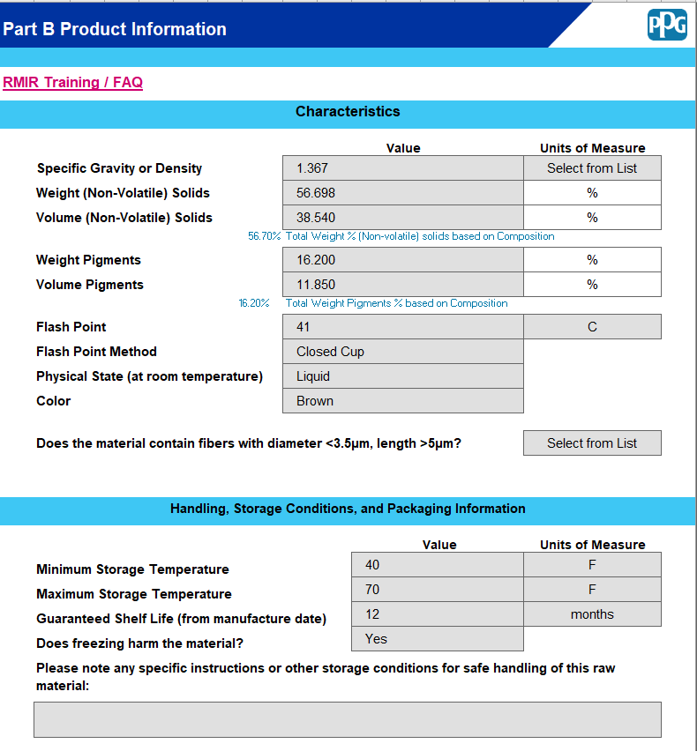

Part B: Product Information
The Product Information must be consistent with your SDS, Technical Data Sheet or other product information.
The RMIR will calculate the Weight Non Volatile Solids and the Weight Pigments based upon the information you enter in the RMIR Composition Section (Part C).
You will see a message appear as a reference for you to adjust or correct your entry.
The next slide explains more
*Make sure the information provided on the RMIR is consistent with your product information (SDS and TDS)

Slide 8
What is Binder, Solvent, Pigment?
PPG’s data system requires that each component or ingredient in your product be identified as one of the following types:
Pigment
Solvent
Binder
Refer to the definition below and in the RMIR Composition Section (Part C) to guide your data entry.
The % Weight Solids and % Weight Pigments in the RMIR Product Information (Tab B) must agree with your entry in the Composition section (Tab C)

Slide 9
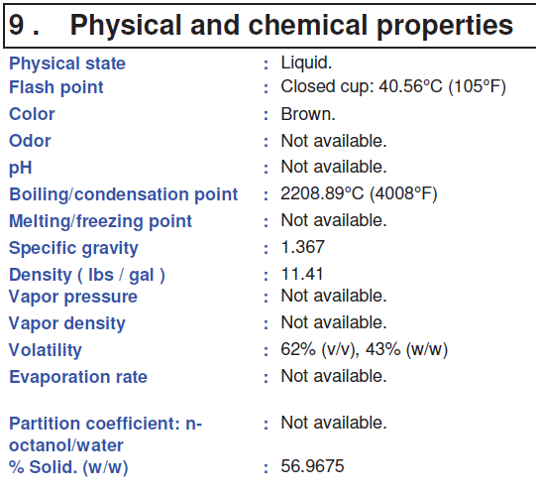
Part B: Product Information
The Product Information must be consistent with your SDS, Technical Data Sheet or other product documents.
550°C
*Make sure the information provided on the RMIR is consistent with your product information (SDS and TDS)

Slide 10
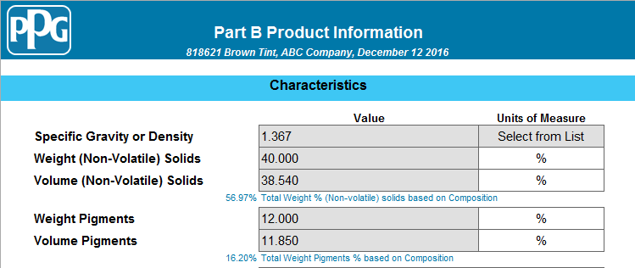

Does the provided Product Information agree with the Composition?
The % solids and % pigments values that you enter in the Product Information Section (Tab B) must match the values that are entered in the Composition Section (Tab C). The RMIR will display the information so you can easily compare and correct it if needed.

Slide 11
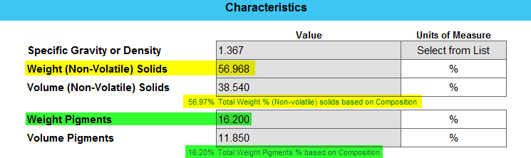


Does the provided Product Information agree with the Composition?
The % solids and % pigments values provided in the Product Information Section must match the values that are entered in the Composition Section. The RMIR display shows the information matches.
Binder + Pigment = % Solids

Slide 12
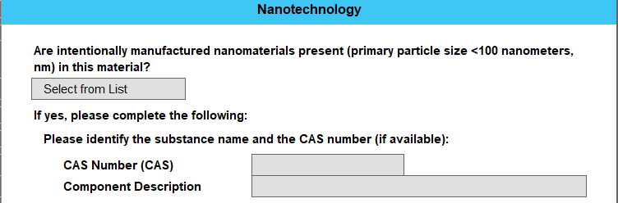
Does the Raw Material Contain Nanotechnology?
PPG defines nanomaterials as <100 nm. If added intentionally, please include the CAS Number and Component Description for the nanotechnology.
Please select Yes or No from the dropdown menu.

Slide 13
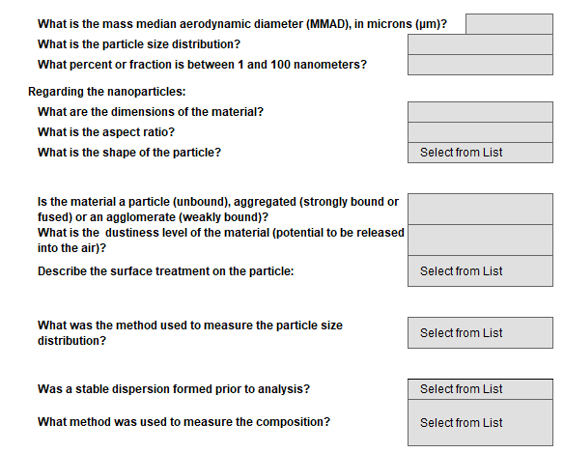
Nanotechnology: Further Information Required for Hazard Evaluation
Please fill out the following fields if it was indicated “Yes” to the presence of intentionally manufactured nanomaterials.
Completing this section ensures we have an accurate hazard evaluation of the raw material.

Slide 14

Part C - Composition
Why does PPG ask suppliers to provide 100% of the composition of raw materials and / or products?

Slide 15
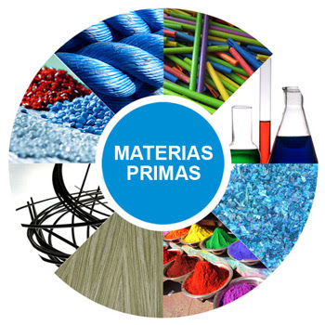
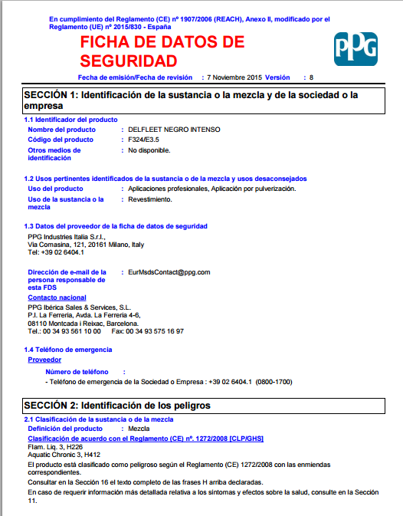

PPG uses the composition to evaluate the potential hazard of your product (our raw material) used in our facilities and in the products we manufacture and sell
PPG requires all of the hazardous and non-hazardous components of the product you supply to evaluate the potential risk
Chemical Substances
Finished Product
SDS products PPG
Mixtures
Substances & Mixtures

Slide 16
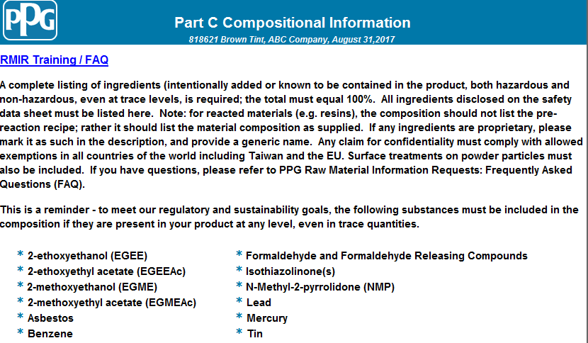
Part C: Compositional Information
It is important to read and understand PPG requirements for the composition
Include these substances, even if present in trace quantities

Slide 17
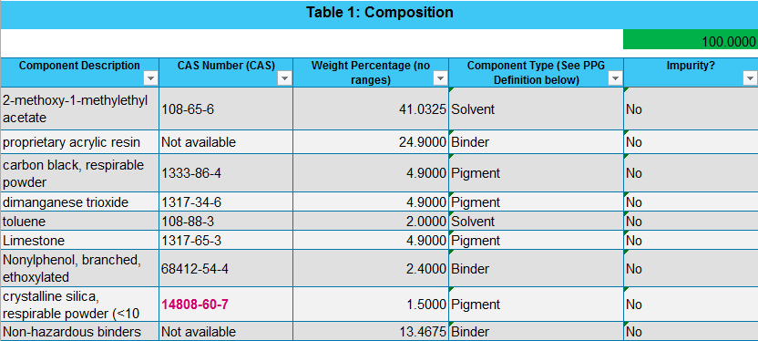
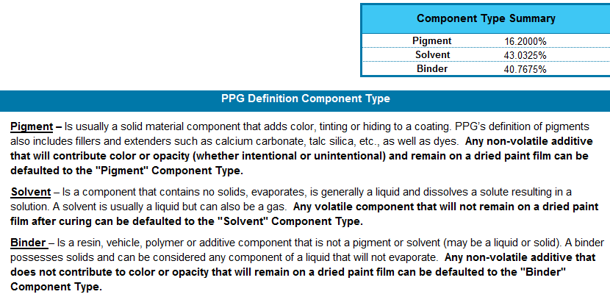
The next several slides will show examples of correct and incorrect information

Slide 18
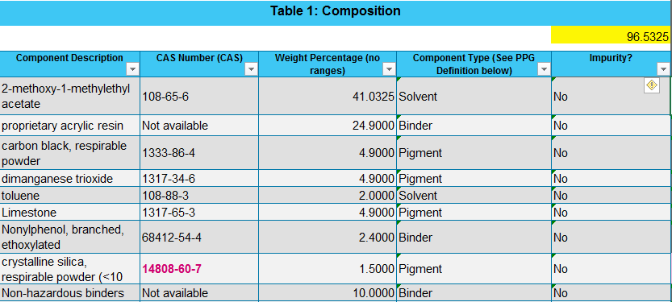
The Composition must equal 100%
The RMIR will calculate the total %. The RMIR does not accept ranges.
You must select a value.

Slide 19
How to manage product composition ranges
If your product SDS lists ranges, the % listed on the PPG RMIR must be within the range. Here are some examples:
Example 1
Incorrect: Component A SDS <20% vs RMIR 20%
Correct: Component A SDS <20% vs RMIR 20%
Correct: Component A SDS <20% vs RMIR 19%
Example 2
Incorrect: Component A SDS 20-30% vs RMIR 31%
Correct: Component A SDS 20-30% vs RMIR 30%

Slide 20

The Composition must equal 100%
The RMIR will calculate the total %. The RMIR does not accept ranges.
You must select a value. This example is correct.

Slide 21

The Component Description and CAS# must be correct
CAS# 1317-34-4 is not a valid CAS#.
The correct CAS# for manganese trioxide is 1317-34-6.
CAS# 100-41-4 is not toluene.
The correct CAS# for Toluene is 108-88-3.

Slide 22

Include all Components – Hazardous AND Non-Hazardous – PPG is GLOBAL – different countries have different definitions of hazardous
All Hazardous Components are reported shaded in yellow
If there are components reported in the Regulatory Information Section of the SDS (typically Sect. 15), be sure these are included in the RMIR composition (Tab B) even if at trace levels.
All Non-hazardous Components are reported.

Slide 23
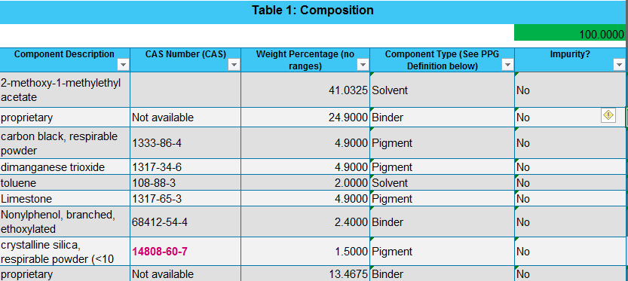
Include CAS# if available
Provide a general description for proprietary or trade secret components
One of the non-proprietary ingredients is reported without a CAS#.
The proprietary ingredients are provided with names that are too generic. We must have a descriptive name.

Slide 24
Has the composition section been completed correctly?
All non-proprietary ingredients are reported with a CAS#.
The proprietary ingredients are provided with descriptive names and specific percentages.

Slide 25
Has the composition section been completed correctly?
The component type and impurity fields are selected for all ingredients.

Slide 26
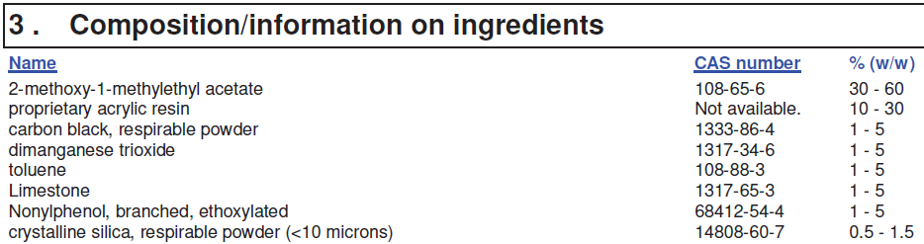
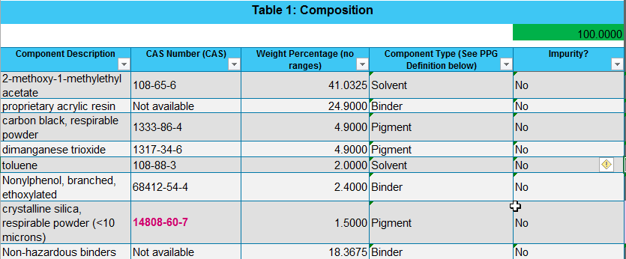
Has the composition section been completed correctly?
CAS# 1317-65-3 is reported on the SDS but is not included on the RMIR.

Slide 27
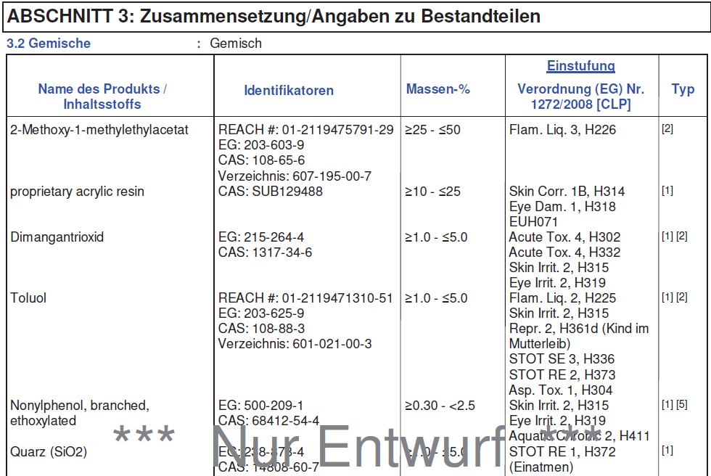
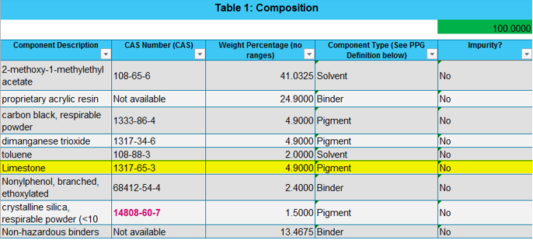
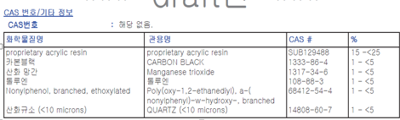
All ingredients disclosed on the SDSs are reported on the RMIR
English SDS
German SDS
RMIR
PPG expects ALL ingredients or components to be included in the RMIR. If a specific component (CAS#) is included in your product, but is only shown on the SDS for one country, we expect it to be included in the composition.
Example: CAS# 1317-65-3 is only found on the English SDS – include it in the RMIR
Korean SDS

Slide 28
Special Case Substances
If one of the following CAS#s are in the provided composition additional information will be needed
Additionally petroleum distillates (i.e. naphtha) require EC number
Indicate the particle size greater than < or less than > l0 microns
1317-95-9 (silica)
14464-46-1 (silica cristoballite)
Indicate the molecular weight
25036-25-3 (bisphenol a-epichlorohydrin reaction product)
Indicate specific component information
28182-81-2 (HDI polymer)
14059-33-7 (bismuth vanadate)
14808-60-7 (quartz)
15468-32-3 (tridymite)
67924-34-9 (epoxy resin)
28064-14-4 (phenol, polymer with formaldehyde, glycidyl ether)
25068-38-6 (epoxy resin)
25322-69-4(propylene glycol)
409-21-2 (silicon carbide)
65997-17-3 (glass oxides)
65997-18-4 (frits, chemical)
This information helps develop the hazard classifications and warnings that PPG assigns

Slide 29
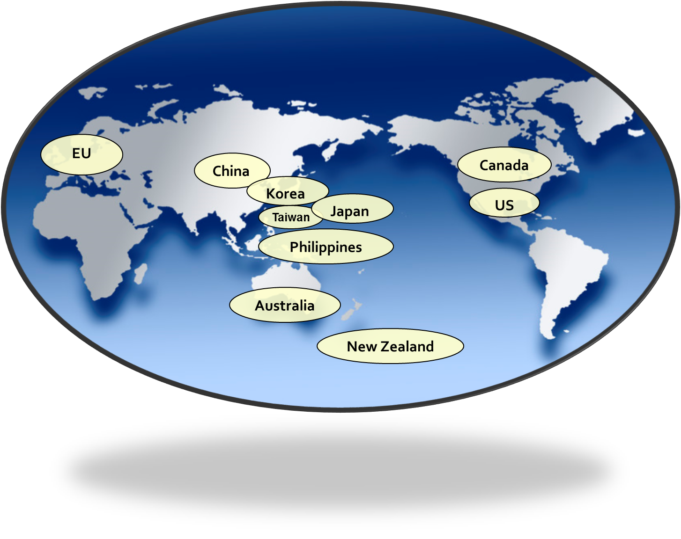
Part D Regulatory Information
PPG is a global company and has an obligation to evaluate raw materials and products against several global regulatory requirements
We expect product manufacturers to know the regulatory status of the products they market and sell
In some cases, the regulatory status will determine if PPG can use your product globally or if its use is limited to a region, country, application, or not to be used
The following slides will provide an overview of the Chemical Inventory Information which is included in Part E

Slide 30
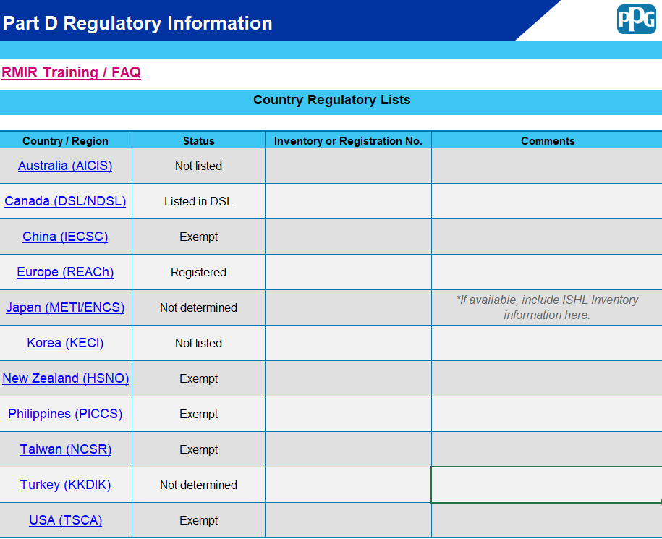
Part D: Regulatory Information
Currently there are 11 Chemical Inventories included on the RMIR
We require the status for ALL locations
Use the drop down selections
Listed
Not Listed
Exempt
Not Determined
Registered (Europe)
Listed in DSL (Canada)
Listed in NDSL (Canada)
Listed Active (TSCA)
Listed Inactive (TSCA)
*If the status is exempt be sure to put a comment explaining why
Example: Naturally Occurring Substance

Slide 31
How to complete the Regulatory Section
Please be aware that the blue underlined Country/Regions in the RMIR are actually links to the individual chemical inventories.
These links can be used to help you determine the status of each component in the composition of the product you intend to sell to PPG.
  If any component is not listed for a specific country or region, the raw material should be reported with an overall status of “Not Listed” on the RMIR.
  If your investigation does not lead you to a clear determination, for the product you sell to PPG, use the “Not Determined” status.
  PPG expects your company to know the product you are selling and to be aware of the chemical inventory status.
  The chemical inventory status entered on the RMIR should agree with information provided on your product SDS or other documents.
You can find additional guidance in the Raw Material Information Requests: Frequently Asked Questions (FAQ).

Slide 32
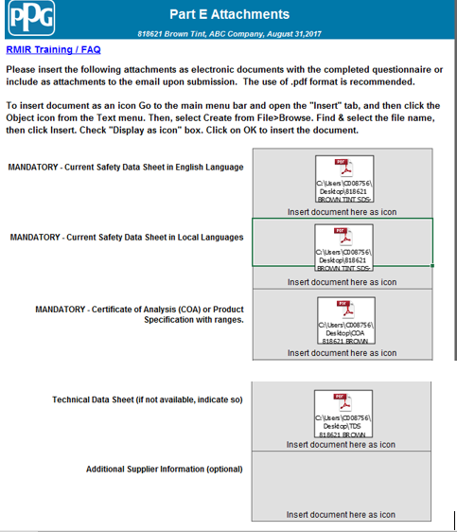
Part E: Attachments
Be sure to attach all relevant documentation
English SDS
SDS of any intended use location
COA
TDS

Slide 33
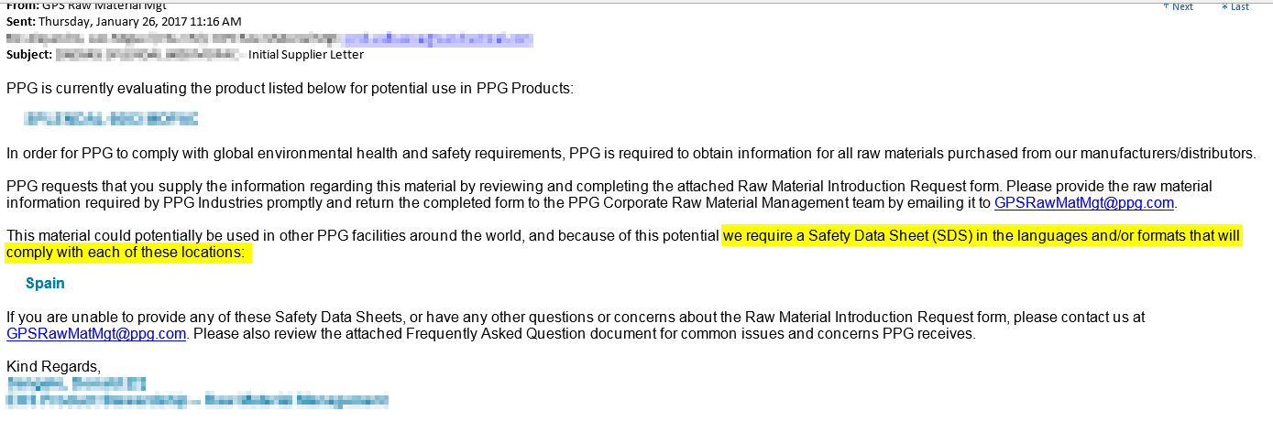
How to know which locations SDS are required for
Please pay attention – we will provide the locations we need SDSs for
If you do not receive this email, communicate with your PPG contact for more information

Slide 34
Completed RMIR
Manufacturer and/or Distributor Information
Product Information
Regulatory
100% Composition
The PPG Raw Material Management Team and your PPG contact will work with you to resolve any questions. However your material will not be qualified until all issues are resolved.

Slide 35

Avoid these common RMIR questions and errors for fast and efficient processing:
Incorrect/invalid CAS numbers
Composition does not total 100%
The composition on the RMIR is different than what is declared on the SDS
Components on the SDS are not declared on the RMIR
CAS # or concentration differences declared for the same product on the SDS for different regions
Inconsistent/missing regulatory status
Inconsistent/ missing documentation
The % solids provided disagrees with the % solids calculated from the composition
The % pigments provided disagrees with the % pigments calculated from the composition
The ‘component type’ and ‘impurity’ fields are often left blank
The presence of Regulatory Notifications (SNUR/SNAC) and Biocides are rarely reported
The most current RMIR form is not used

Slide 36
PPG’s Material Qualification Process
PPG is a global company and has established requirements to help ensure that the materials we purchase and use in products have current and complete information (from the RMIR and product safety data sheets- SDS).
Once your material is qualified, you are required to provide updated information if there are changes to the Safety Data Sheet, your product classification, chemical inventory status, or raw material specifications.

Slide 37

Please Complete the RMIR following these instructions as well as the FAQ.
Review the RMIR Example.
Feel free to contact PPG if you have any questions. GPSRawMatMgt@ppg.com
Thank you!

